Slide 1


Slide 2
Viz Wars: Tableau VS Shiny
Patrick Carlson & Adrian Perez

Slide 3
Overview
We will discuss our experiences, where each tool excels, and their pros and cons. Both tools serve a particular niche.

Slide 4


About Us
Patrick Carlson, PhD
Education:
PhD in Human-Computer Interaction
Sandia National Labs
Data Scientist (April 2017)
Email: pcarlso@sandia.gov
http://carlsonp.github.io/
Adrian Perez
Education
MS in Applied Statistics
Sandia National Labs
Data Scientist (July 2018)
Email: jespere@sandia.gov

Slide 5
Department Visualization Experience
50+ Tableau visualization created
20+ Shiny visualization created

Slide 6
Data Sciences Department
What we do

Slide 7
Sandia National Laboratories Data Science Department
Data Visualizations
Tableau, Shiny, SSRS
Data Virtualization
TIBCO
Data Transformations
ODI, SSIS
Application Development
Web Design, JavaScript, Java Spring Boot, Angular, Docker
Analytics and Machine Learning
R, Python, Microsoft Machine Learning Server

Slide 8
Data Pipeline
Source Database / Data Warehouse
Data Virtualization
Data Analytics & Visualizations

Slide 9








Services & Infrastructure

Slide 10
Example Problem and Solutions
How does the average miles per gallon (MPG) fuel efficiency of cars change by car class/type?

Slide 11
Dataset
Source: R’s ggplot2 mpg
Columns
Manufacturer
Engine displacement
Year of manufacture
Number of cylinders
Type of transmission
Front / read / 4WD
City miles per gallon
Highway miles per gallon
Fuel type
Type of car

Slide 12
Quick Facts: Tableau
Desktop client for authoring
Tableau server for hosting and sharing
Drag-and-drop interface for authoring

Slide 13
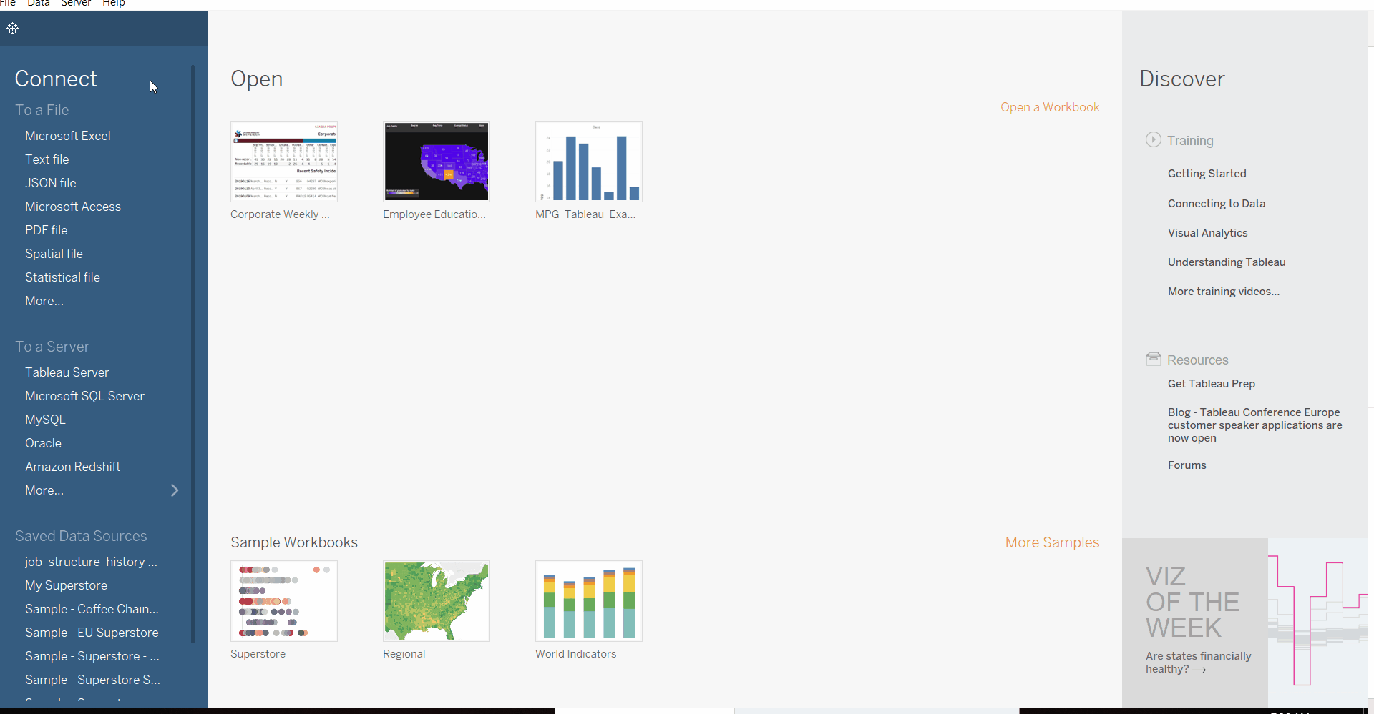
Tableau Desktop

Slide 14
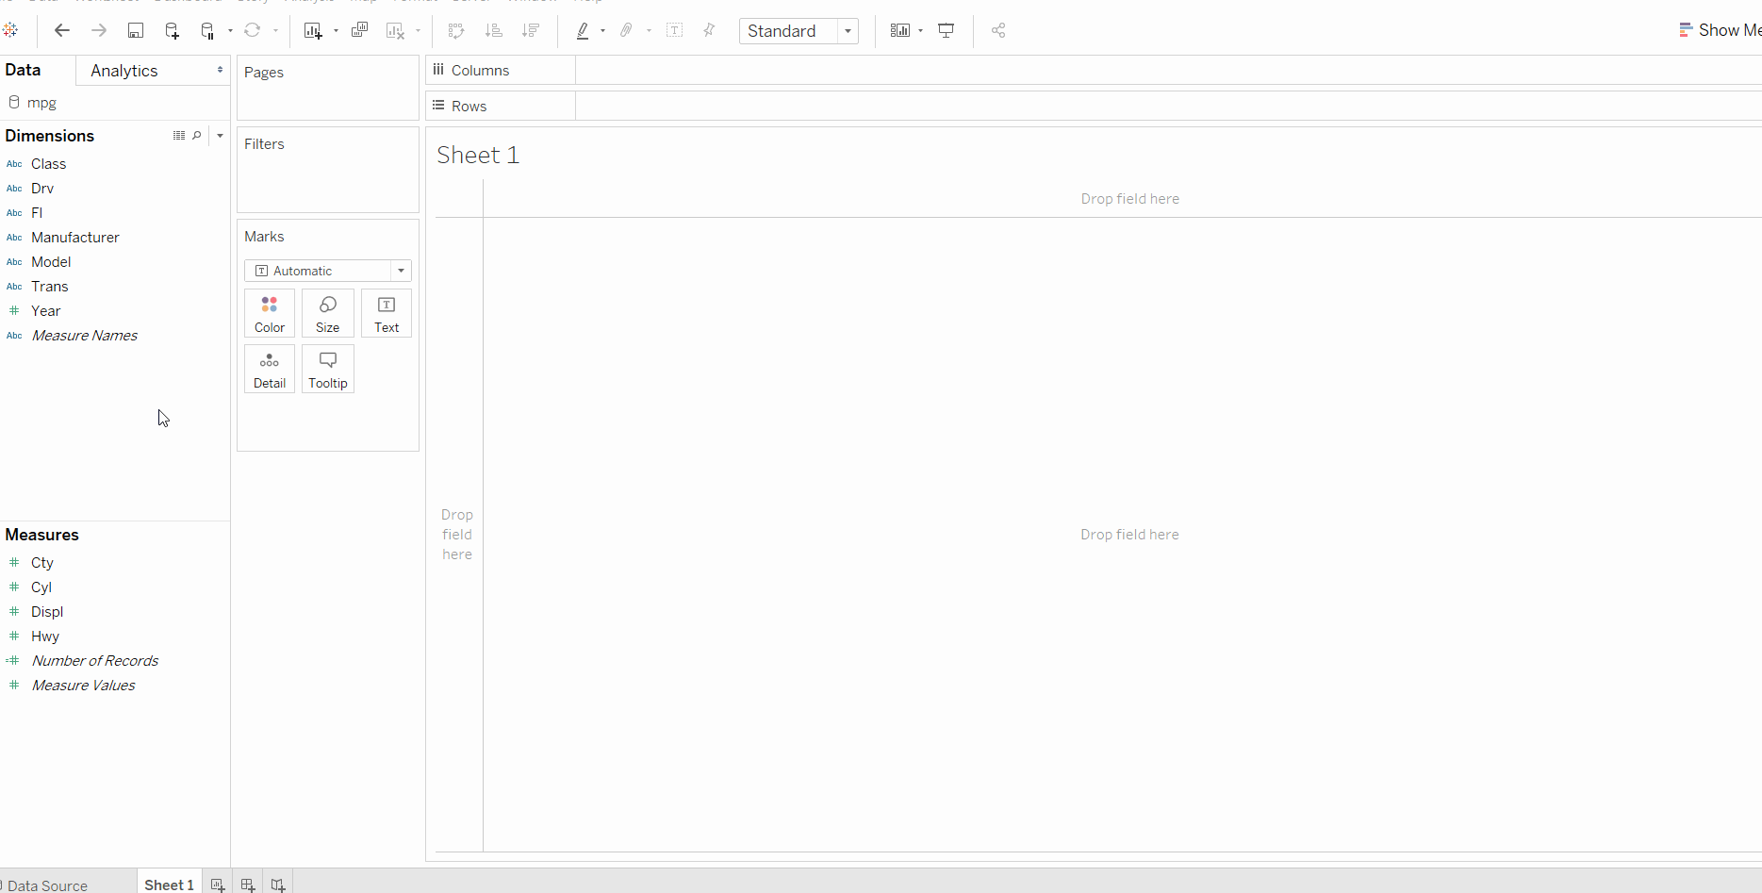
Solution: Tableau

Slide 15
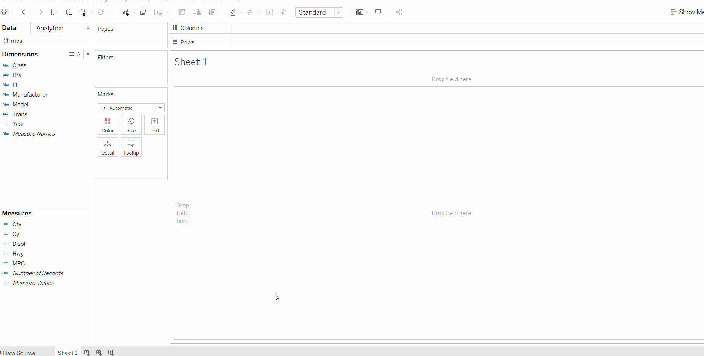
Solution: Tableau

Slide 16
Strengths: Tableau
Easy to learn and simple to use
Drag and drop interface
Fast visualizations on the fly
Customize visualizations (colors, fonts, etc.)
Industry leader
Lots of data connectors
Commercial support and updates
Documentation and example visualizations online
Permissions and administration through web-UI

Slide 17
Weaknesses: Tableau
Manual review of calculations and data pipeline
No templates in Tableau 10.4, start fresh each time
No debugging / visibility into calculations
Cost
Requires desktop license for authoring
Minimal version-control

Slide 18
Best Use Cases: Tableau
Quick graphing and fast turnaround
Ad-hoc work
Lives temporarily
Collaborative projects
Multiple visualizations from a single dataset
Enterprise delivery

Slide 19
Quick Facts: Shiny
RStudio desktop IDE for authoring and local testing
Shiny Server or Shiny Server Pro (paid) for hosting visualizations
Uses the R programming language
Can leverage CRAN packages
Can do more than just visualize data

Slide 20
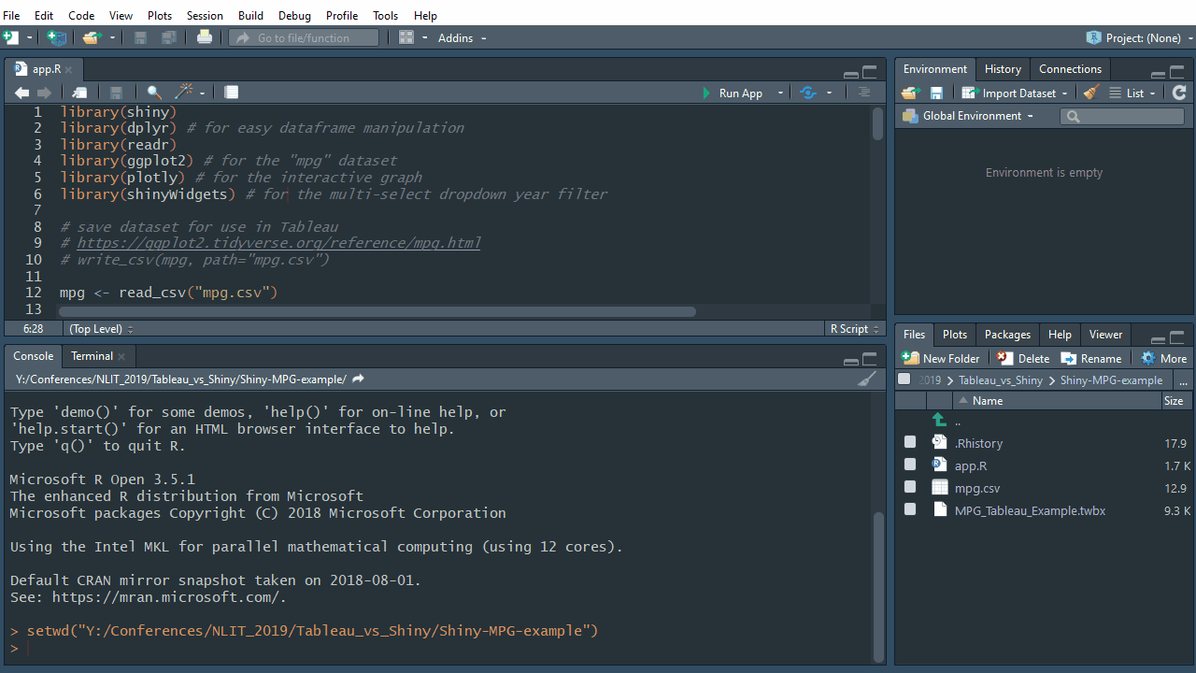
RStudio Desktop

Slide 21
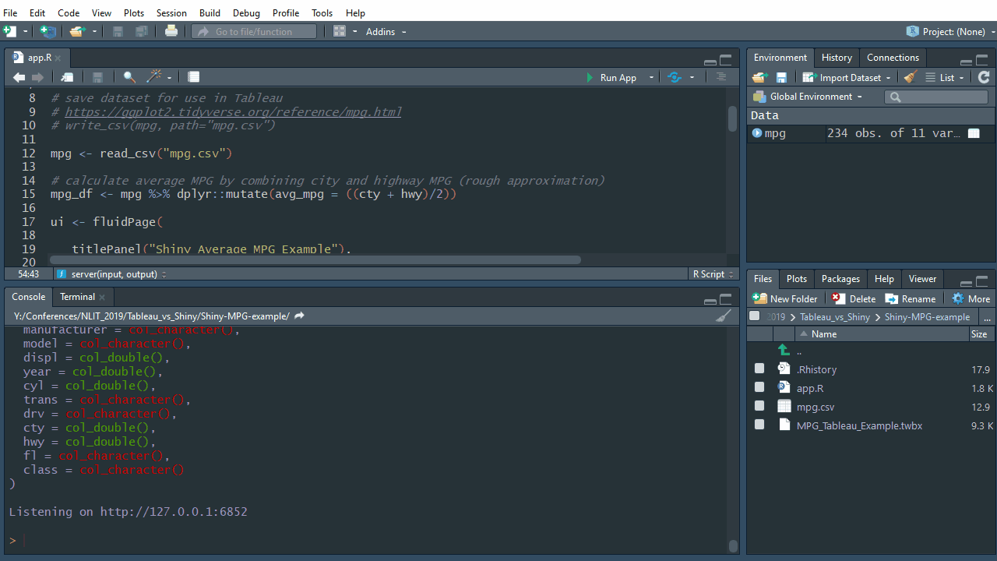
RStudio Desktop

Slide 22
MPG Calculation (approximation)

Slide 23
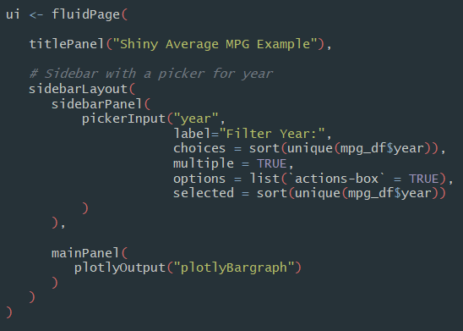
Reactivity in Shiny

Slide 24
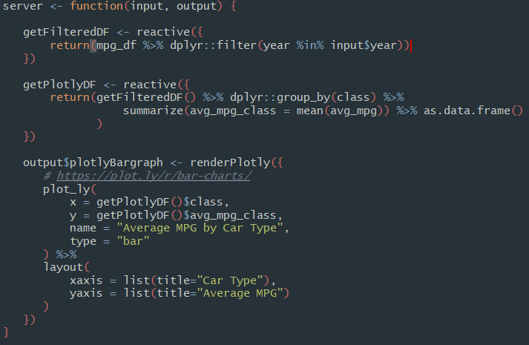
Reactivity in Shiny

Slide 25
Strengths: Shiny
Connects to almost any data source
Provides nearly every chart and graph type
Repeatable / reproduceable
Powerful data manipulation and transformation
Highly customizable
Code can be version-controlled
Free and Open Source
Documentation and example material
Diversity of CRAN packages and leverage Open Source community
RMarkdown, common R language from Data Scientists / Analysts

Slide 26
Weaknesses: Shiny
Requires R programming language and technical expertise
Sometimes requires HTML / Javascript knowledge
Updating server R packages, keeping environments in sync
Less commercial support options
Less popular in industry
Future viability of R over Python or other languages

Slide 27
Best Use Cases: Shiny
High customization
Flexible UI
Data source types not supported by Tableau
Specialty graphs (Sankey, network diagram, etc.)
More data processing or transformations relative to Tableau

Slide 28
Helpful Shiny Packages
Tidyverse (dplyr, stringr, etc.)
Plotly (graphing)
DT (datatables.net)
networkD3 (graph network)
ShinyDashboard (consistent theme/layout)
shinyBS (Bootstrap)
ShinyCSSloaders (loading spinners)
Leaflet (mapping)
shinyWidgets (additional UI widgets)

Slide 29
Conclusion
Both tools serve particular niche areas
Consider:
Technical skills
Investment (cost, training)
User base / size

Slide 30
Additional Examples

Slide 31
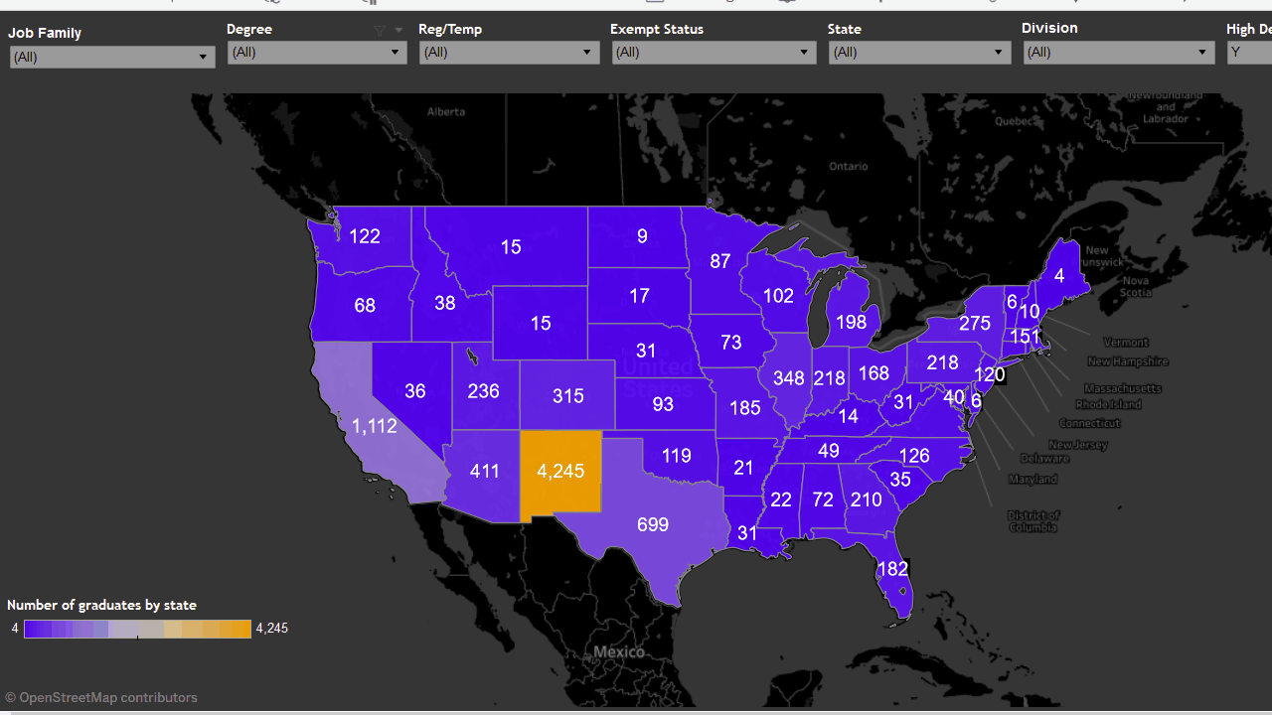
Tableau – Employee Education

Slide 32
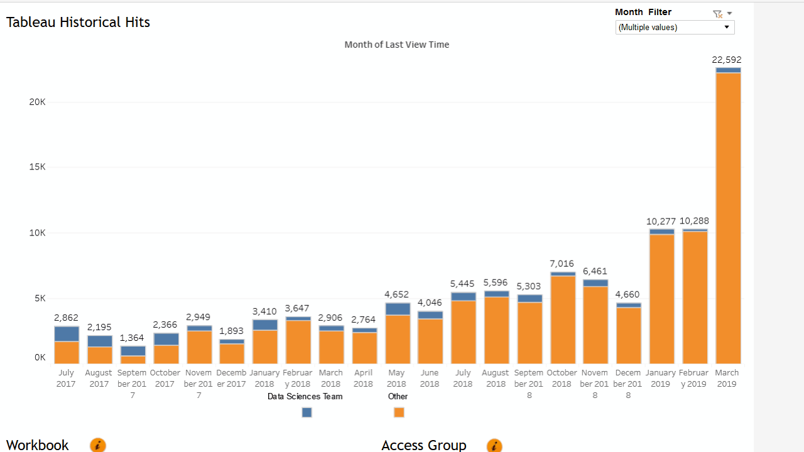
Tableau – Tableau Views

Slide 33
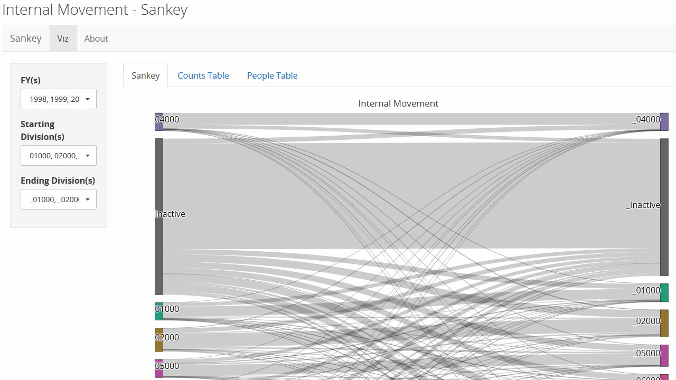
Shiny – Internal Movement

Slide 34
Questions?

Slide 35
“MPG” Example
Tableau and Shiny example files and R code:
https://github.com/carlsonp/NLIT-presentation-2019

Slide 36
Appendix

Slide 37
Learning Resources
Tableau
https://www.tableau.com/learn/training
https://public.tableau.com/en-us/s/authors/
https://public.tableau.com/en-us/s/gallery
Shiny
https://shiny.rstudio.com/tutorial/
R for Data Science by Garrett Grolemund & Hadley Wickham
Interactive web-based data visualization with R, plotly, and shiny by Rob Kabacoff
R Graphics Cookbook by Winston Chang

